Slide 1
RECITATION 8: supply chain examples
15.774/780 (Fall 2021)

Slide 2
Announcements
Project proposal due this Wed. 11/10 at 11:59pm
Examples of projects and proposals on Canvas.
In groups, only one person needs to upload.
Remaining assignments:
HW4 – Collaborative Filtering due 11/19
Case Study - Vungle due 11/22
Case Study - Auctions due 11/24
HW5 - Bandits due 11/26
Final Project Report due 12/8
Notes:
Write formulas on the board before class

Slide 3
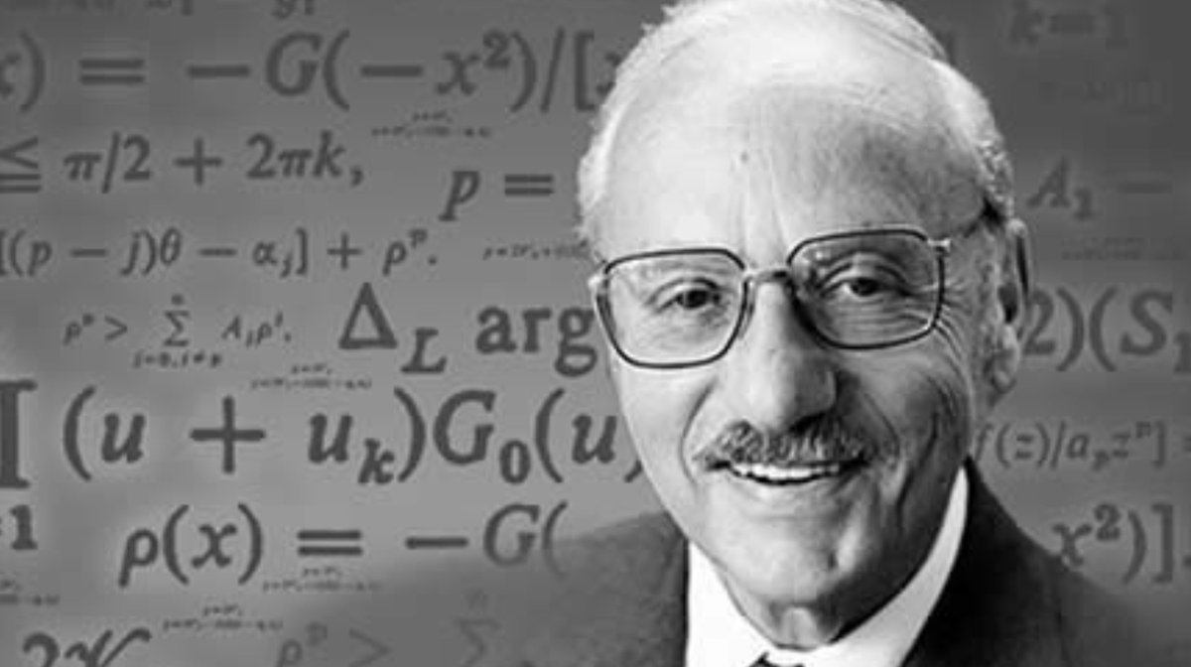
Final Project
Analytics: Use data and models to make a recommendation
to solve a problem.
“The purpose of a theory is to solve the problem that motivated the theory.” – George Dantzig
1. Data
Data cleaning & outliers
Missing value & imputation
Descriptive analysis
2. Models
Regression/Classification
Time Series
MNL
3. Decisions
Optimization
Bandits
Collaborative Filtering
Notes:
Write formulas on the board before class

Slide 4
Final Project
You should convince us that:
Your problem is useful to solve.
Your approach is a reasonable way to solve this problem.
Your approach gives interesting insights/recommendations.
You don’t need to:
Solve climate change or show a $2B increase in profit.
Develop Nobel-prize winning methodology.
Simplifying assumptions and simple models are fine!
But they should be reasonable.
Notes:
Write formulas on the board before class

Slide 5
Supply Chain Examples
A Tale of Four Optimizations
Set cover problem
Assignment problem
Traveling Salesman problem
Knapsack problem
Notes:
Write formulas on the board before class

Slide 6

Overview
TurkeyDokey, Inc. is a national turkey retail company that sells turkeys all over the US.
They want to optimize their supply chain to retail buyers across the country.
They have to decide:
Which truck routes will supply which buyers.
How to assign drivers to routes.
In which order a tryck should supply buyers.
What mix of turkeys to load a truck with.
Set Covering Problem
Assignment Problem
Traveling Salesman
Knapsack Problem
Notes:
Write formulas on the board before class

Slide 7
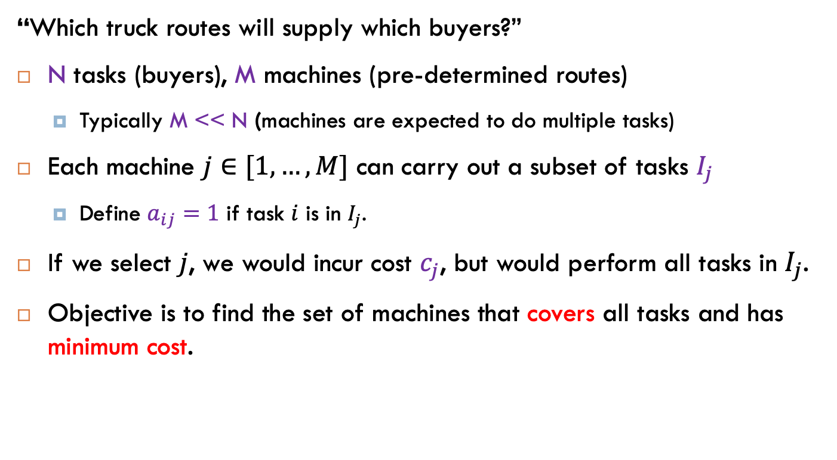
1. Set Cover Problem
“Which truck routes will supply which buyers?”
N tasks (buyers), M machines (pre-determined routes)
Typically M << N (machines are expected to do multiple tasks)
Each machine $j∈[1,…,M]$ can carry out a subset of tasks $I_{j}$
Define $a_{ij}=1$ if task $i$ is in $I_{j}$.
If we select $j$, we would incur cost $c_{j}$, but would perform all tasks in $I_{j}$.
Objective is to find the set of machines that covers all tasks and has minimum cost.
Notes:
Write formulas on the board before class

Slide 8
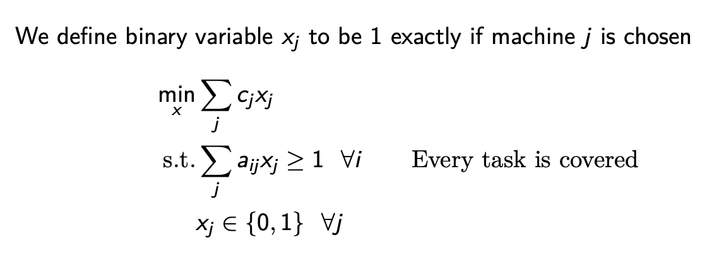
1. Set Cover Problem
Notes:
Write formulas on the board before class

Slide 9
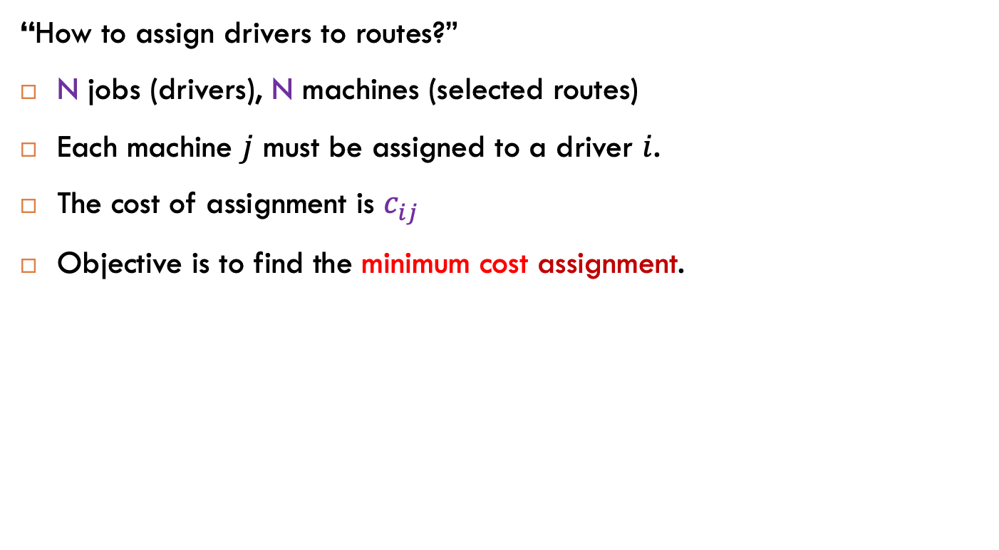
2. Assignment Problem
“How to assign drivers to routes?”
N jobs (drivers), N machines (selected routes)
Each machine $j$ must be assigned to a driver $i$.
The cost of assignment is $c_{ij}$
Objective is to find the minimum cost assignment.
Notes:
Write formulas on the board before class

Slide 10
2. Assignment Problem
Notes:
Write formulas on the board before class

Slide 11
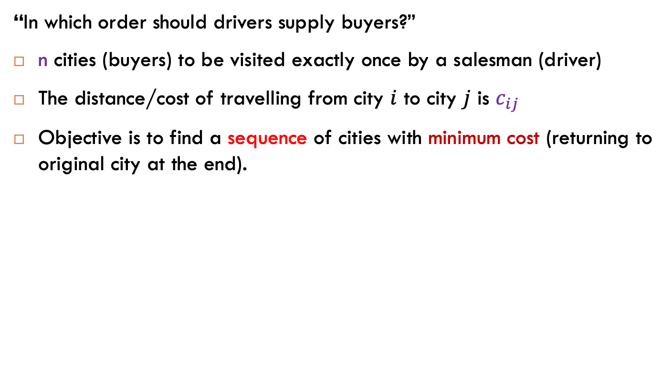
3. Traveling Salesman
“In which order should drivers supply buyers?”
n cities (buyers) to be visited exactly once by a salesman (driver)
The distance/cost of travelling from city $i$ to city $j$ is $c_{ij}$
Objective is to find a sequence of cities with minimum cost (returning to original city at the end).
Key Observation 1
Every city must be arrived to (once) and left from (once)
A
B
D
C
Notes:
Write formulas on the board before class

Slide 12
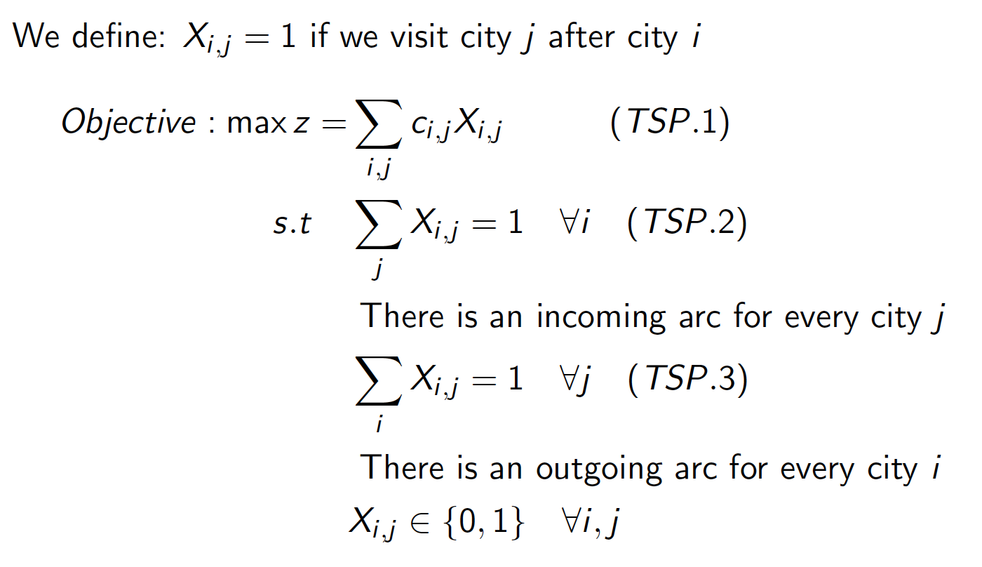
3. Traveling Salesman
But there’s a problem….
Notes:
Write formulas on the board before class

Slide 13
3. Traveling Salesman
This is a valid solution…
Every city has an incoming edge.
Every city has an outgoing edge.
Key Observation 2
Every subset of cities must be arrived to (once) and left from (once).
A
B
D
C
Notes:
Write formulas on the board before class

Slide 14
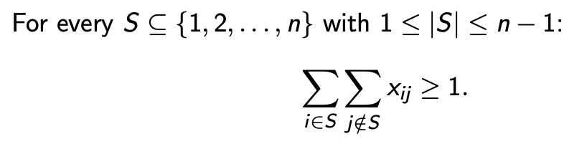
3. Traveling Salesman
So let’s add subtour elimination constraints:
But there’s so many subsets! In practice, we use lazy constraints.
Get solution without any subtour constraints.
If solution has a subtour, add constraint and resolve.
Rinse. Lather. Repeat.
Typically you only need to repeat a few times! This works great in practice.
Notes:
Write formulas on the board before class

Slide 15
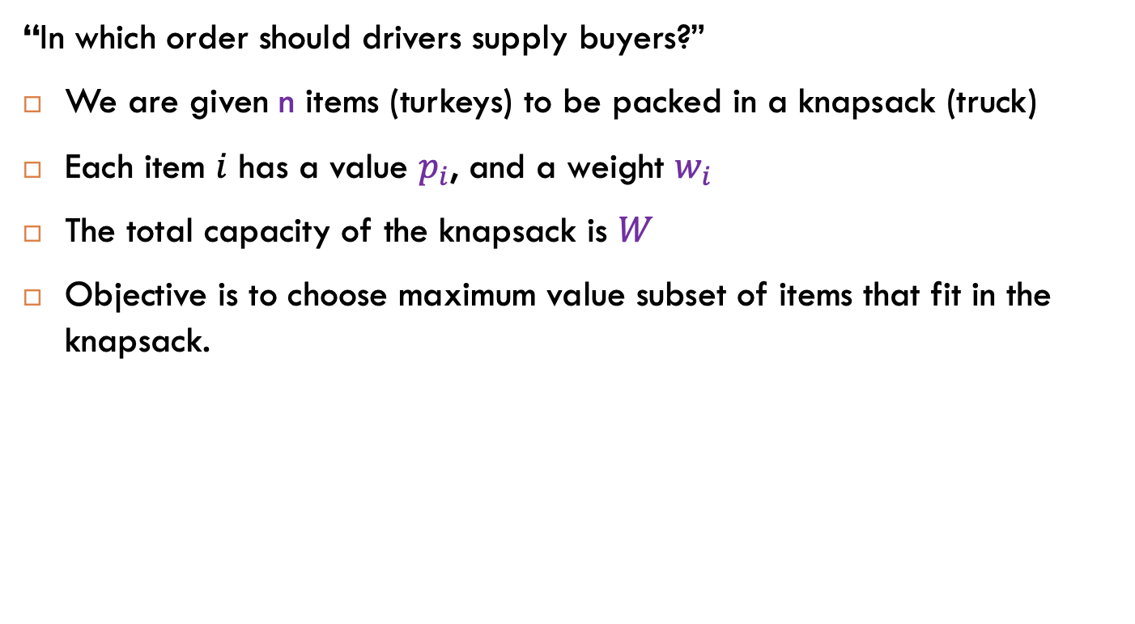
4. Knapsack problem
“In which order should drivers supply buyers?”
We are given n items (turkeys) to be packed in a knapsack (truck)
Each item $i$ has a value $p_{i}$, and a weight $w_{i}$
The total capacity of the knapsack is $W$
Objective is to choose maximum value subset of items that fit in the knapsack.
Notes:
Write formulas on the board before class

Slide 16
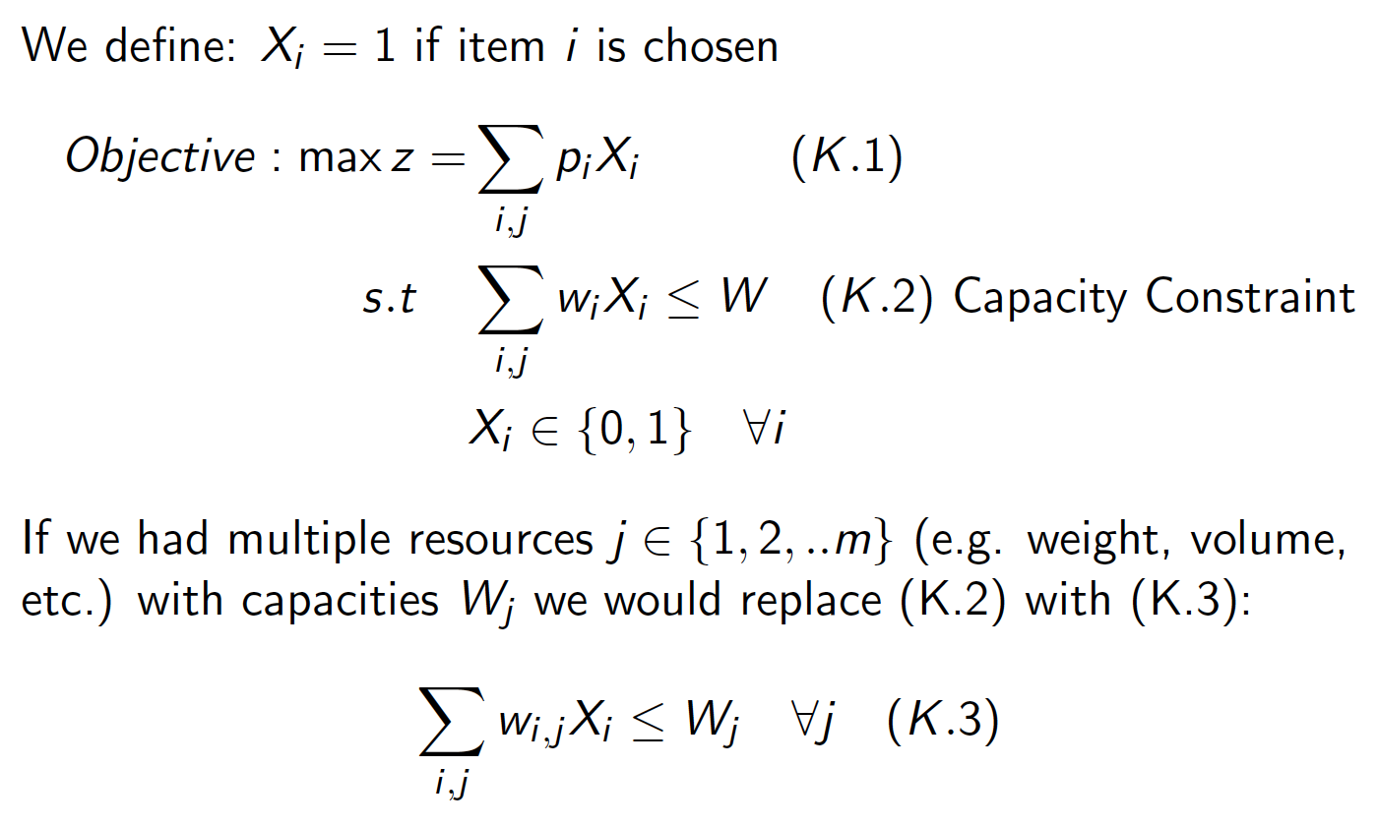
4. Knapsack problem
Notes:
Write formulas on the board before class

